Slide 1
Session 2020-21 CSTE-3101 Communication Engineering

Slide 2
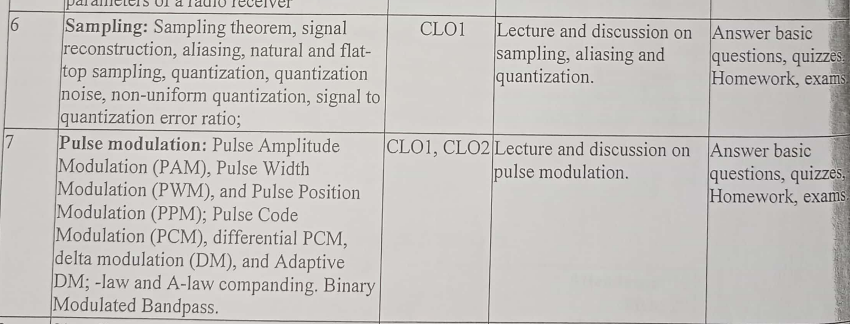

Slide 3
Signal to Noise Ratio

Slide 4
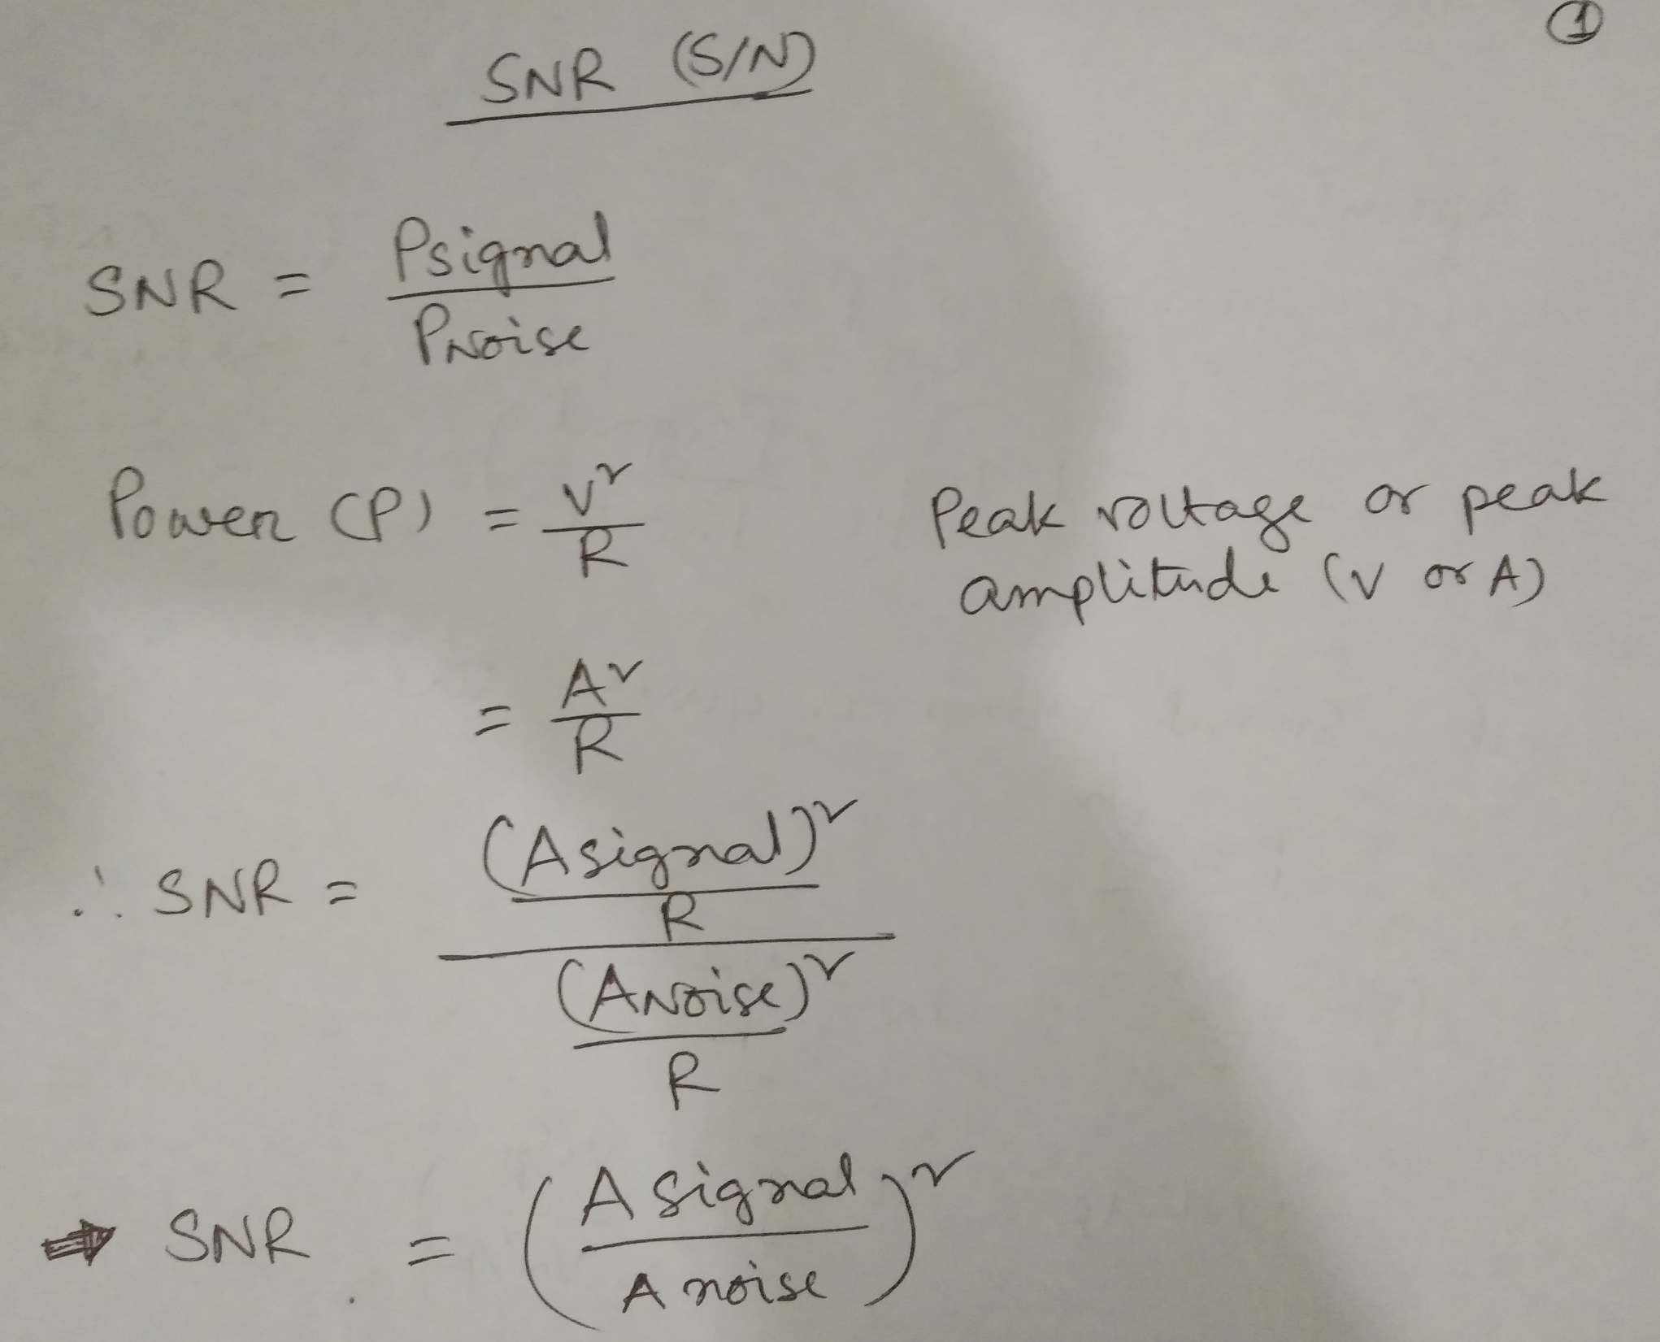

Slide 5
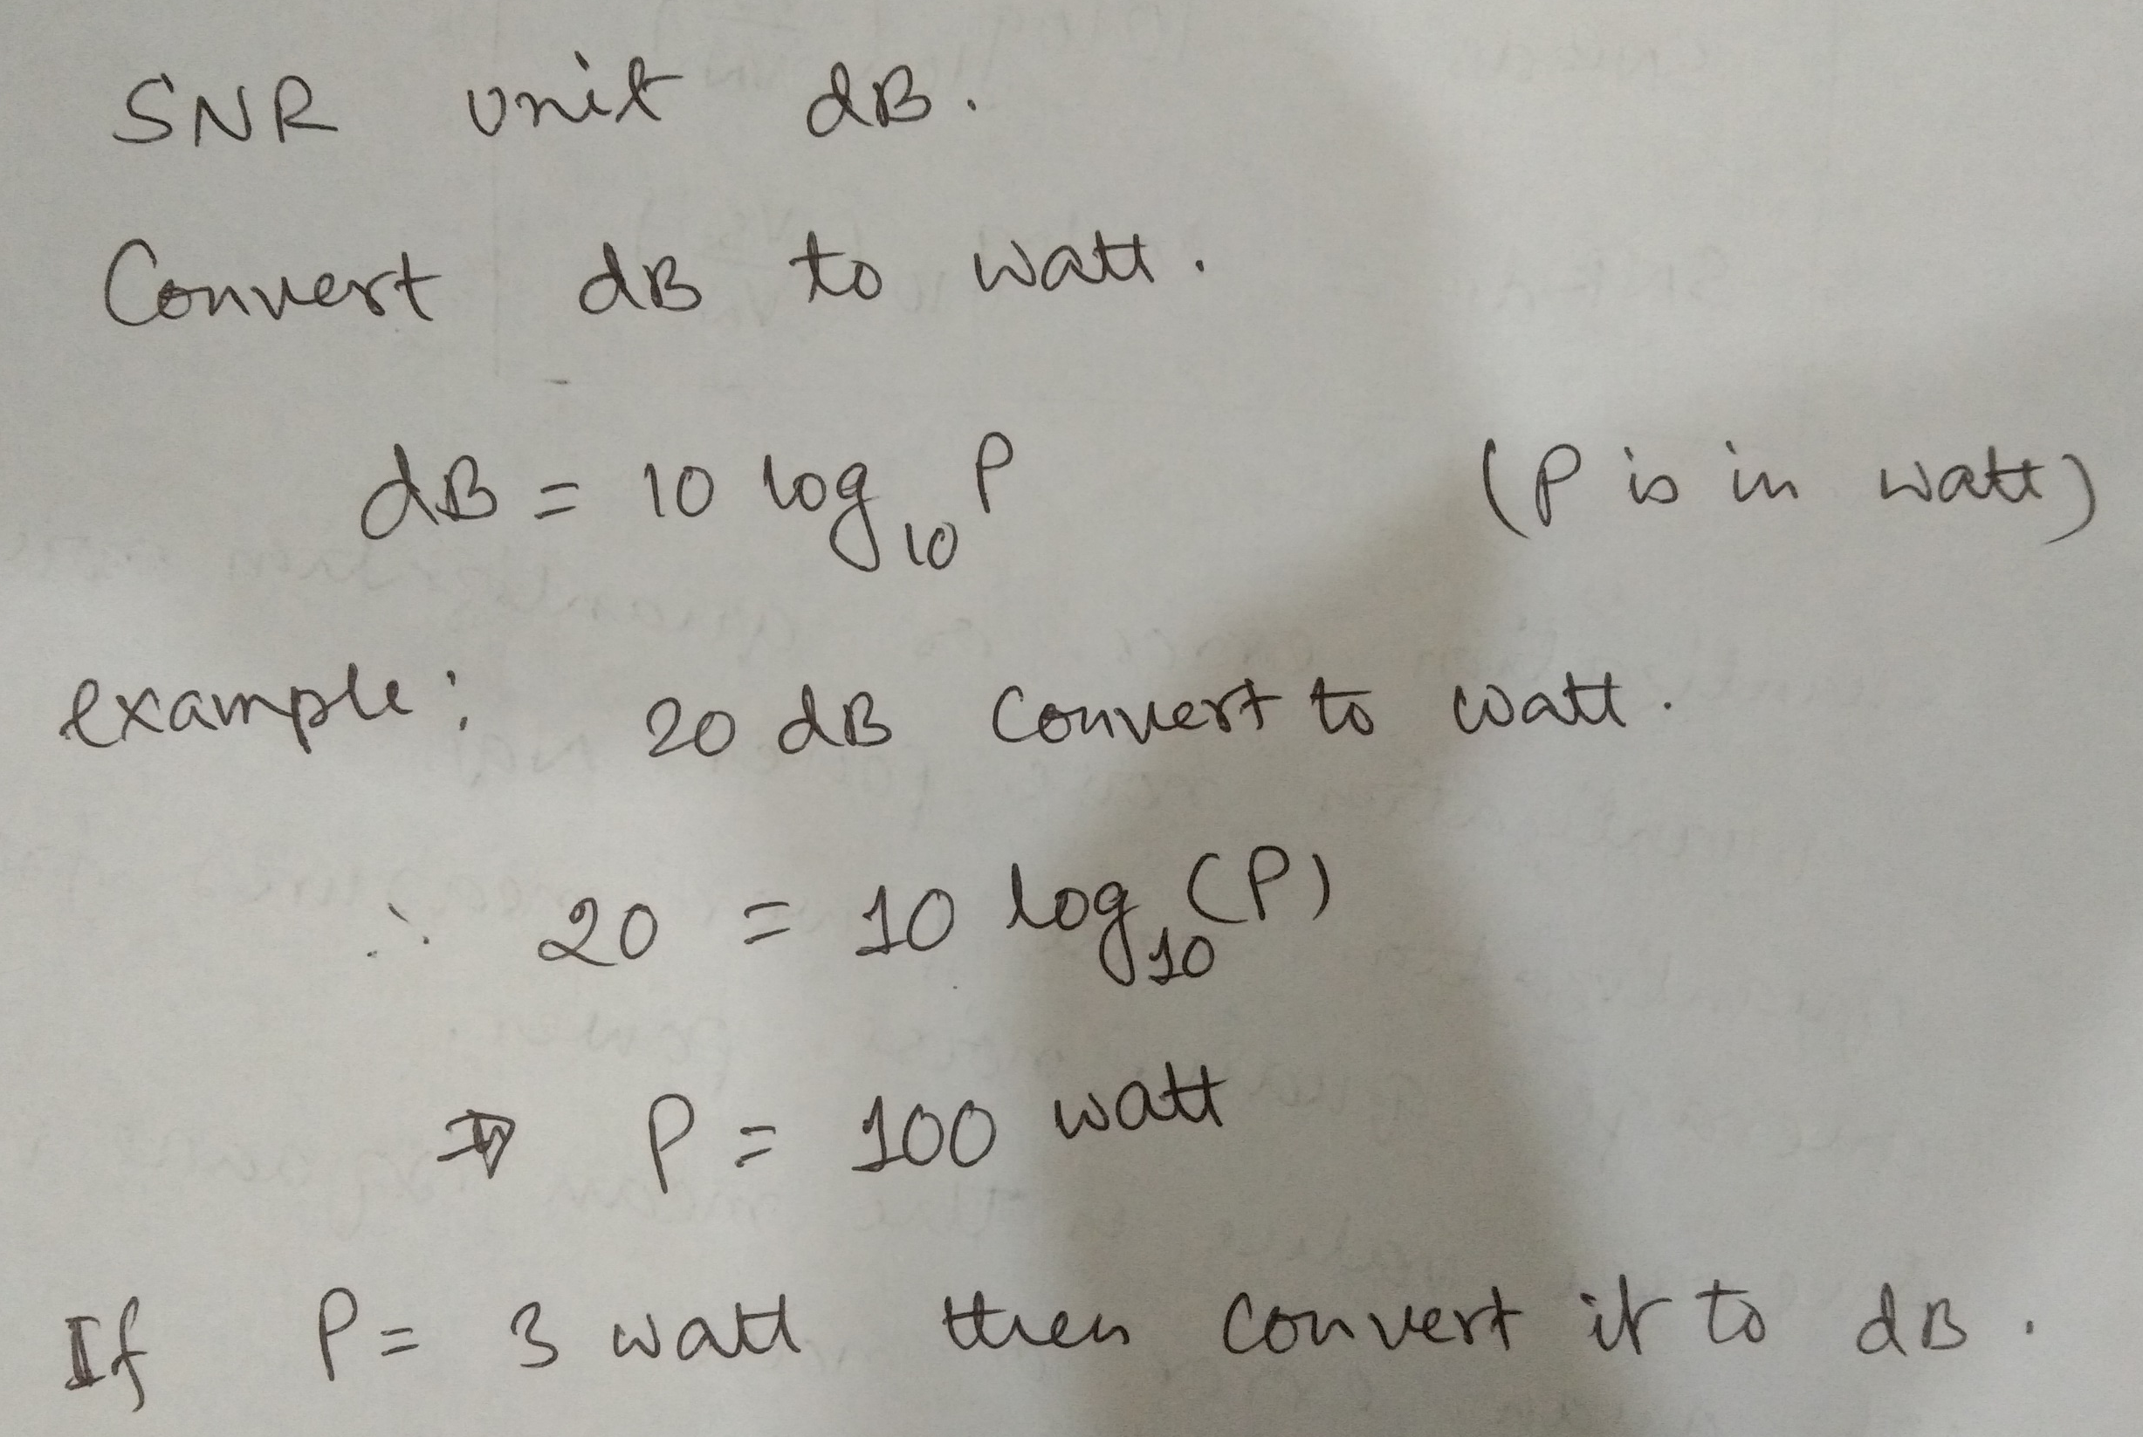

Slide 6
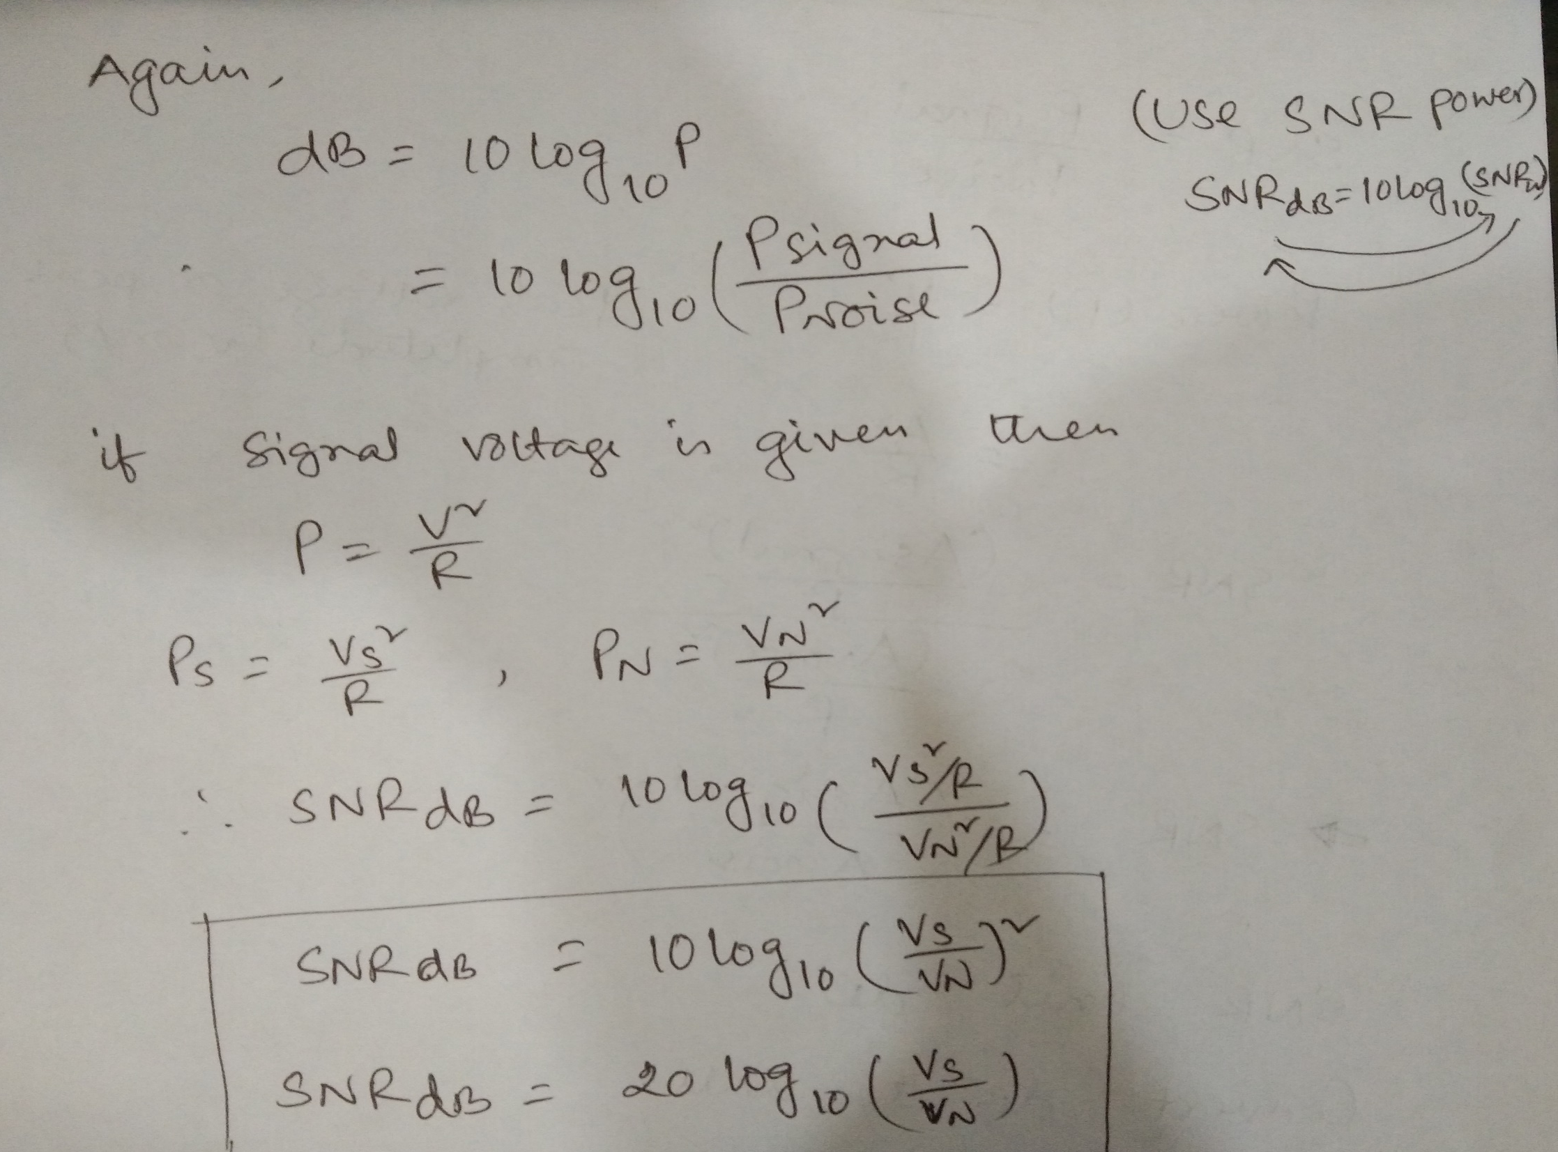

Slide 7
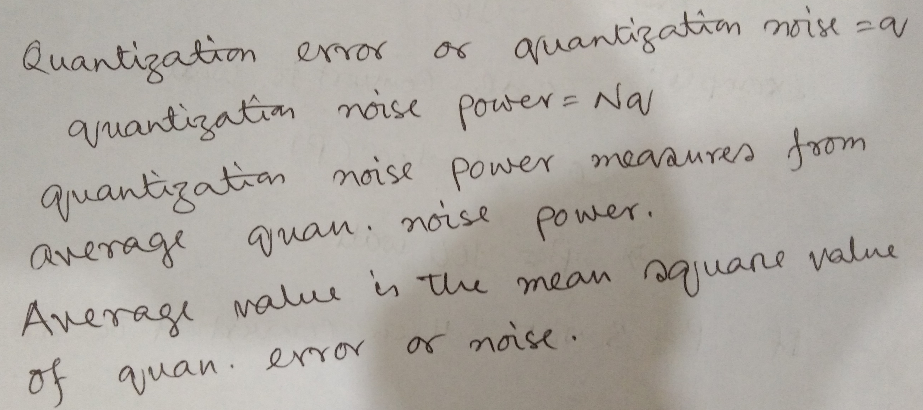

Slide 8
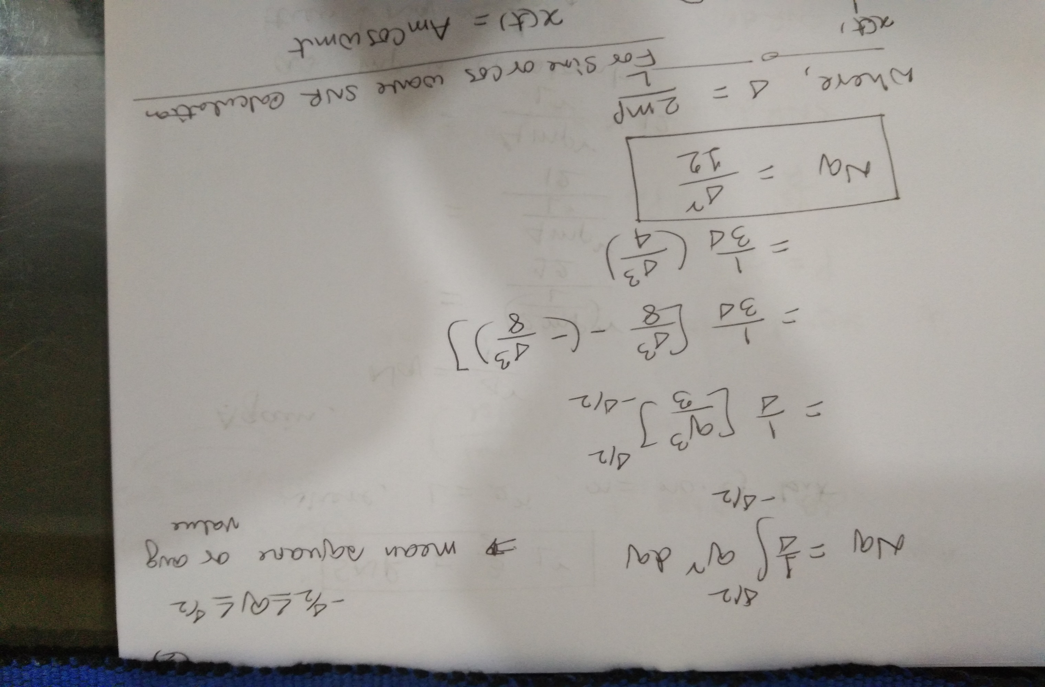

Slide 9
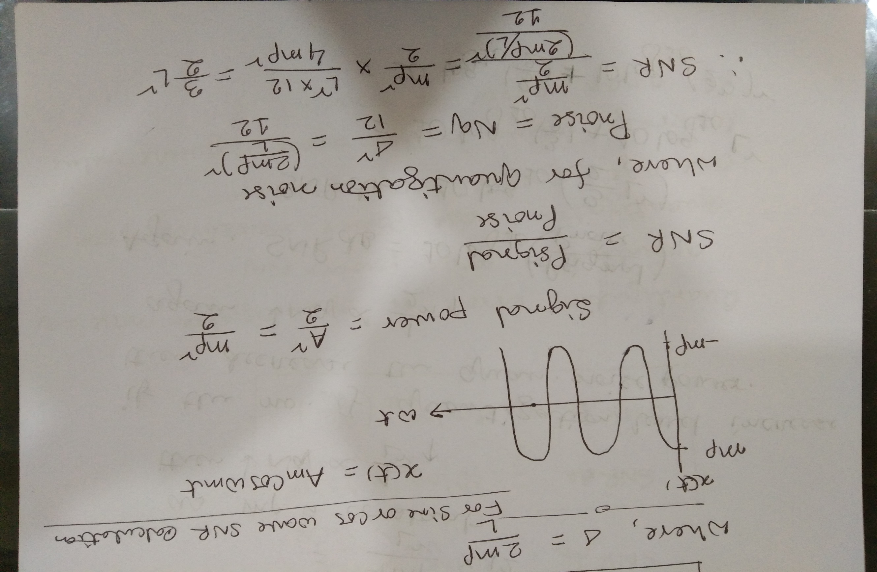

Slide 10
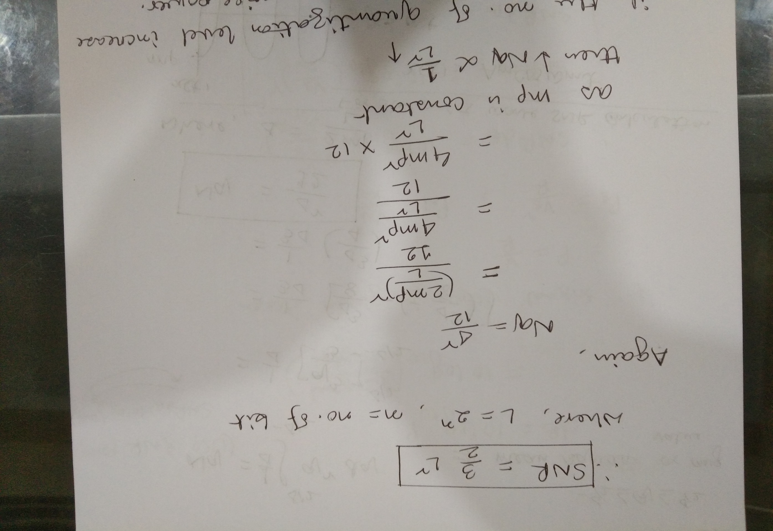

Slide 11
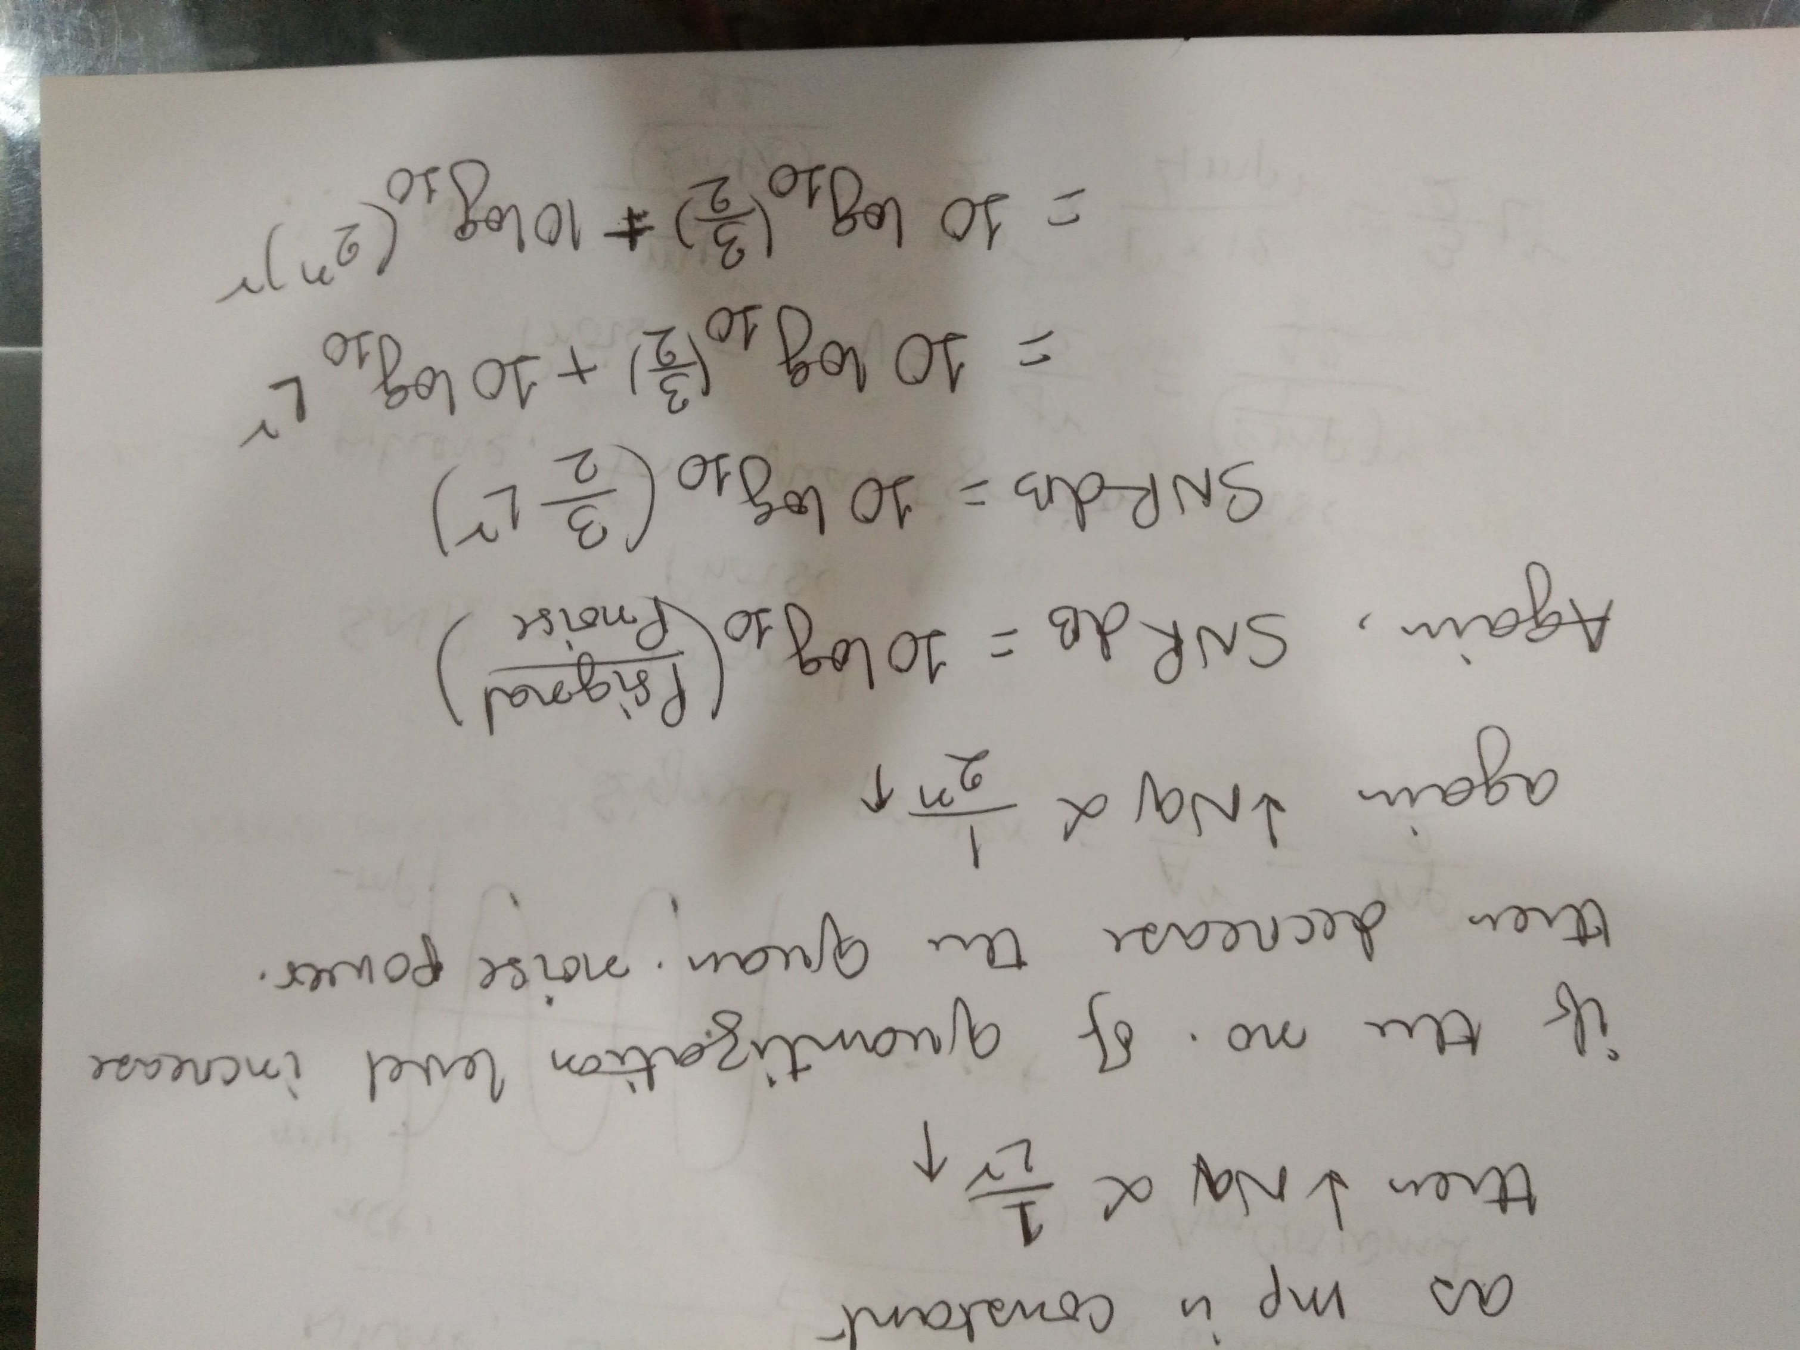

Slide 12
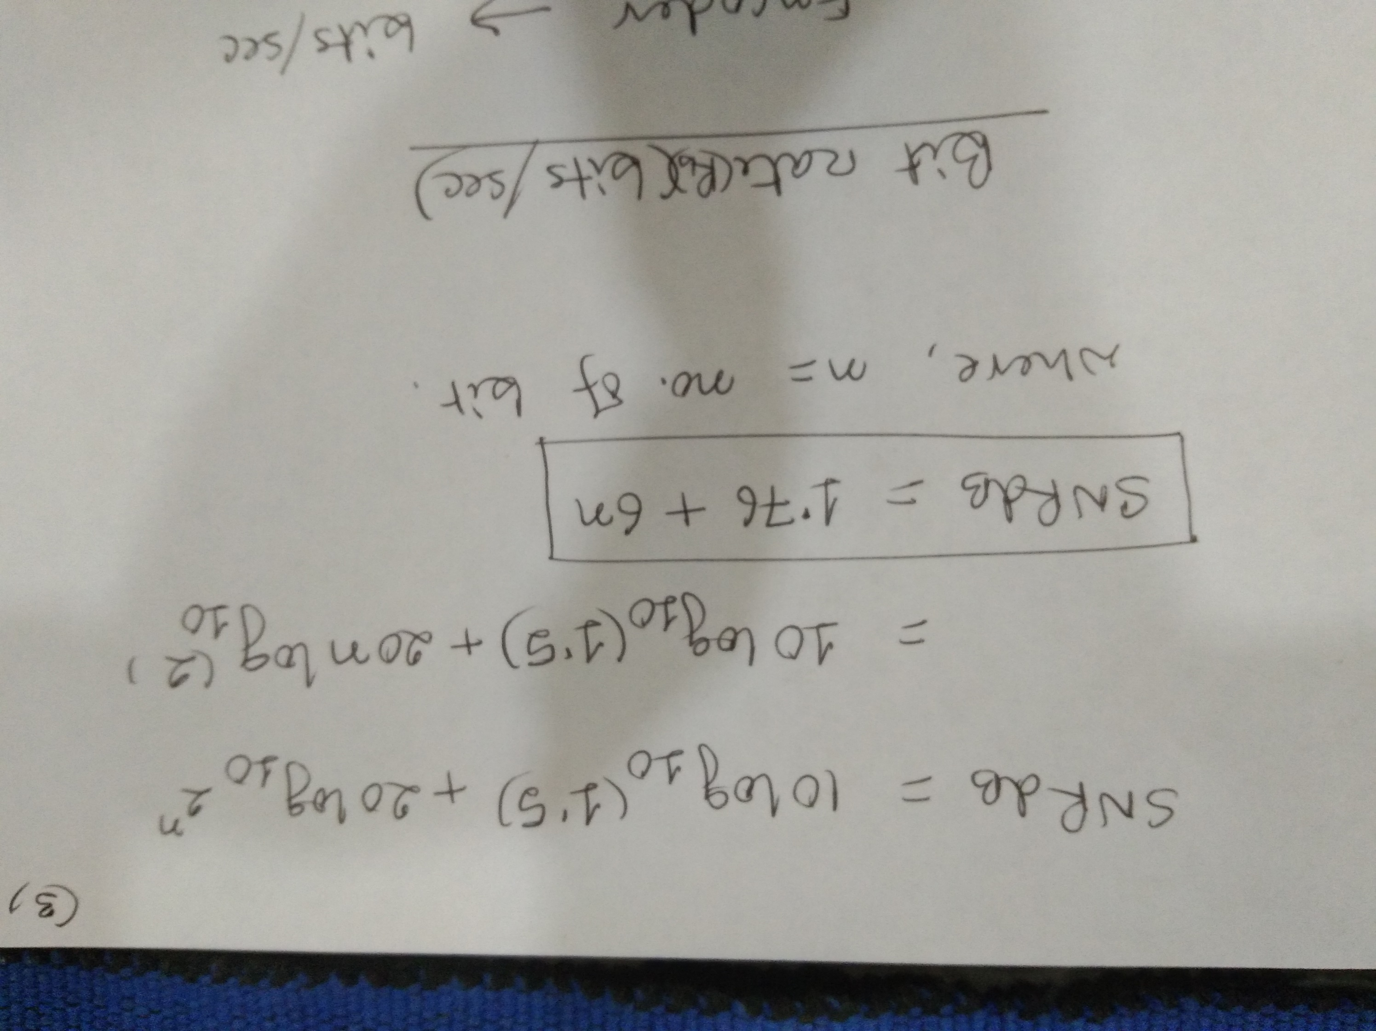

Slide 13
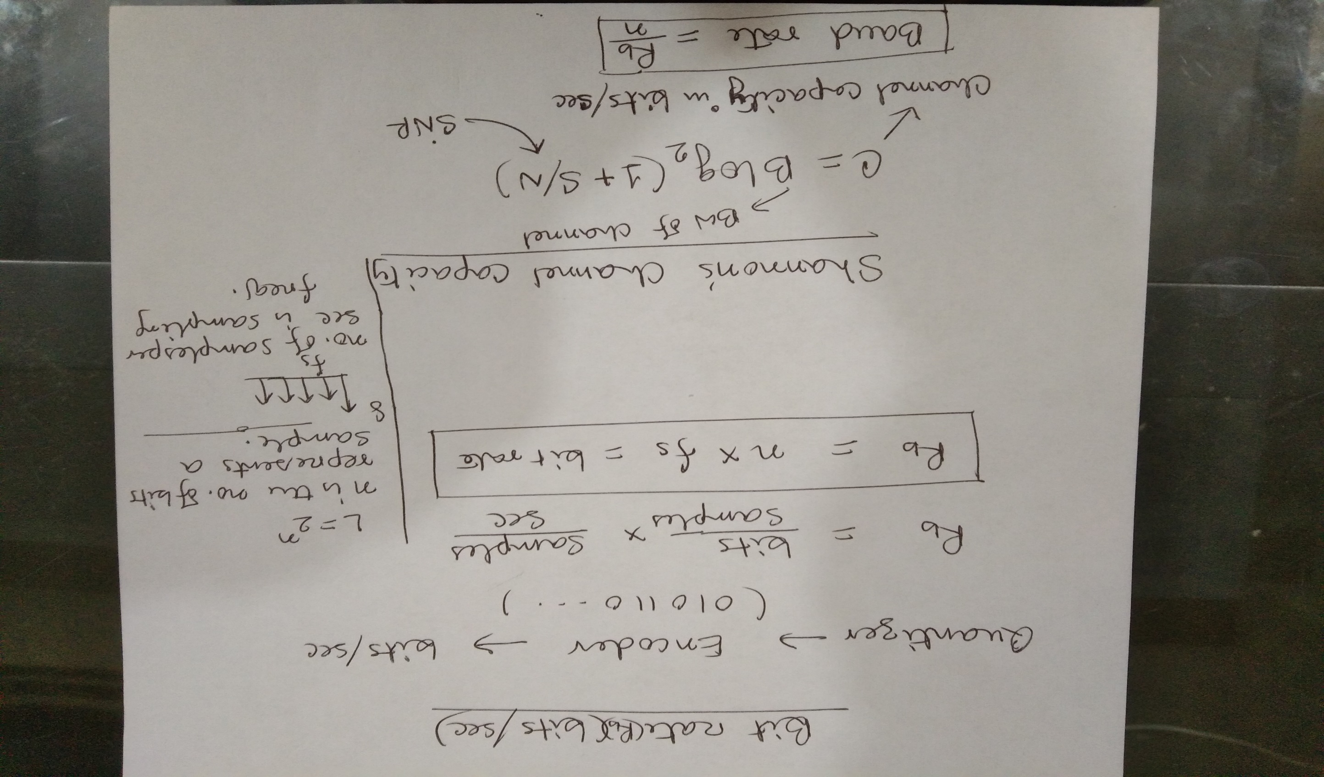

Slide 14
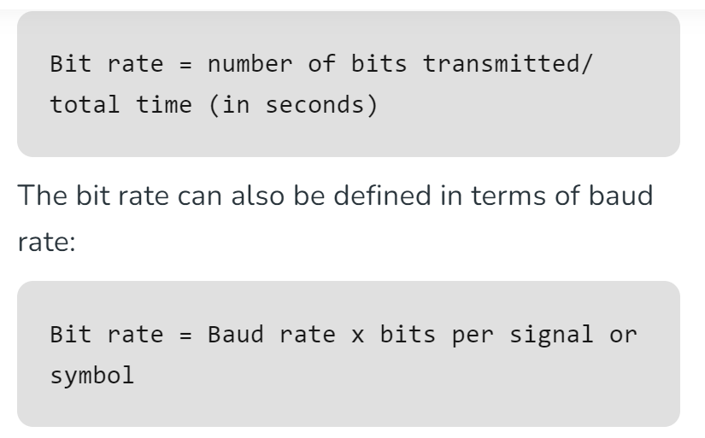

Slide 15
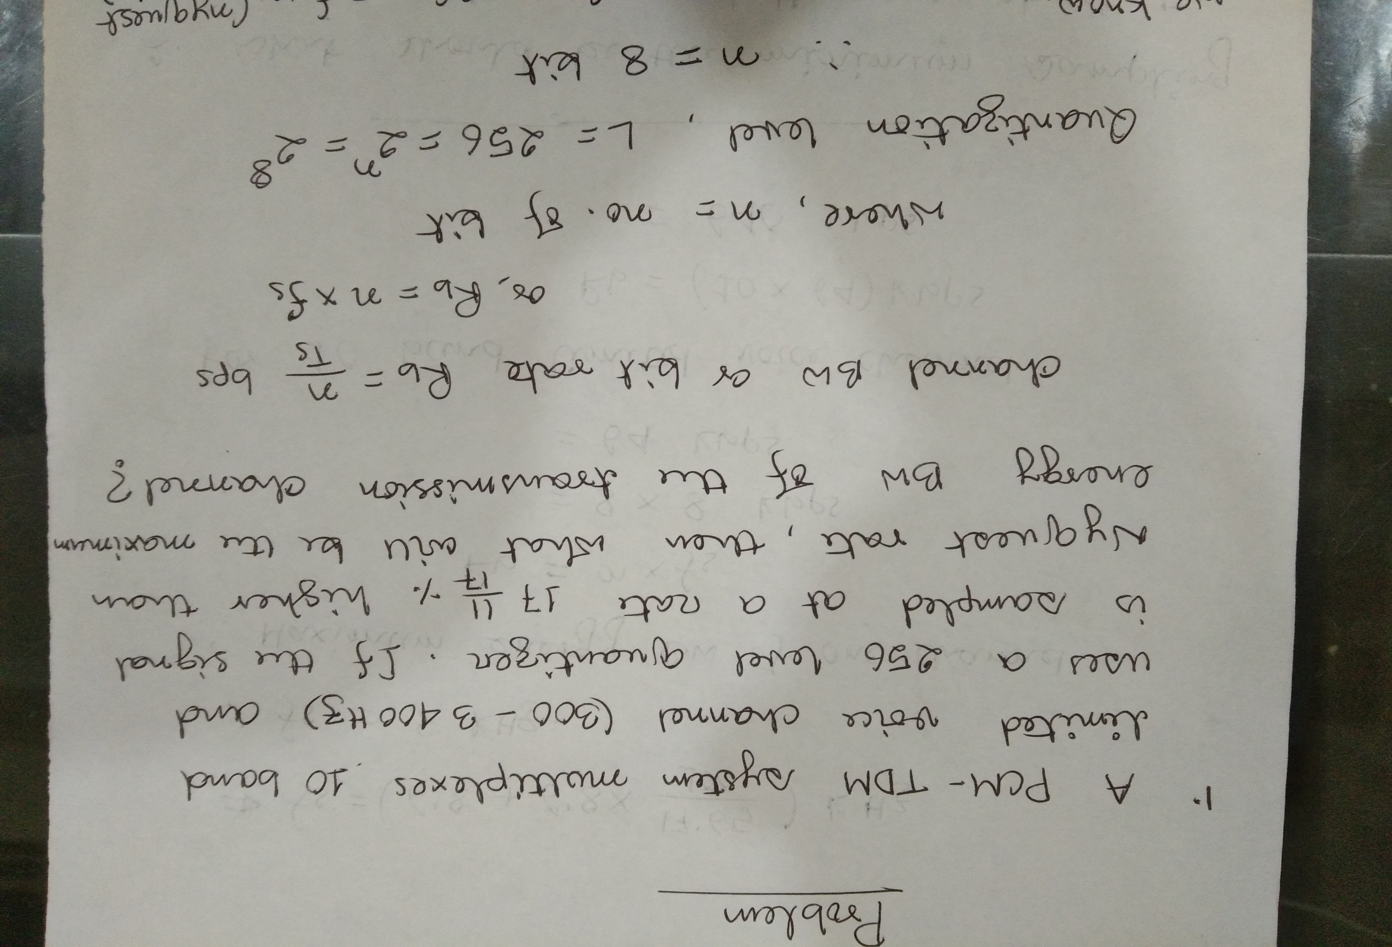

Slide 16
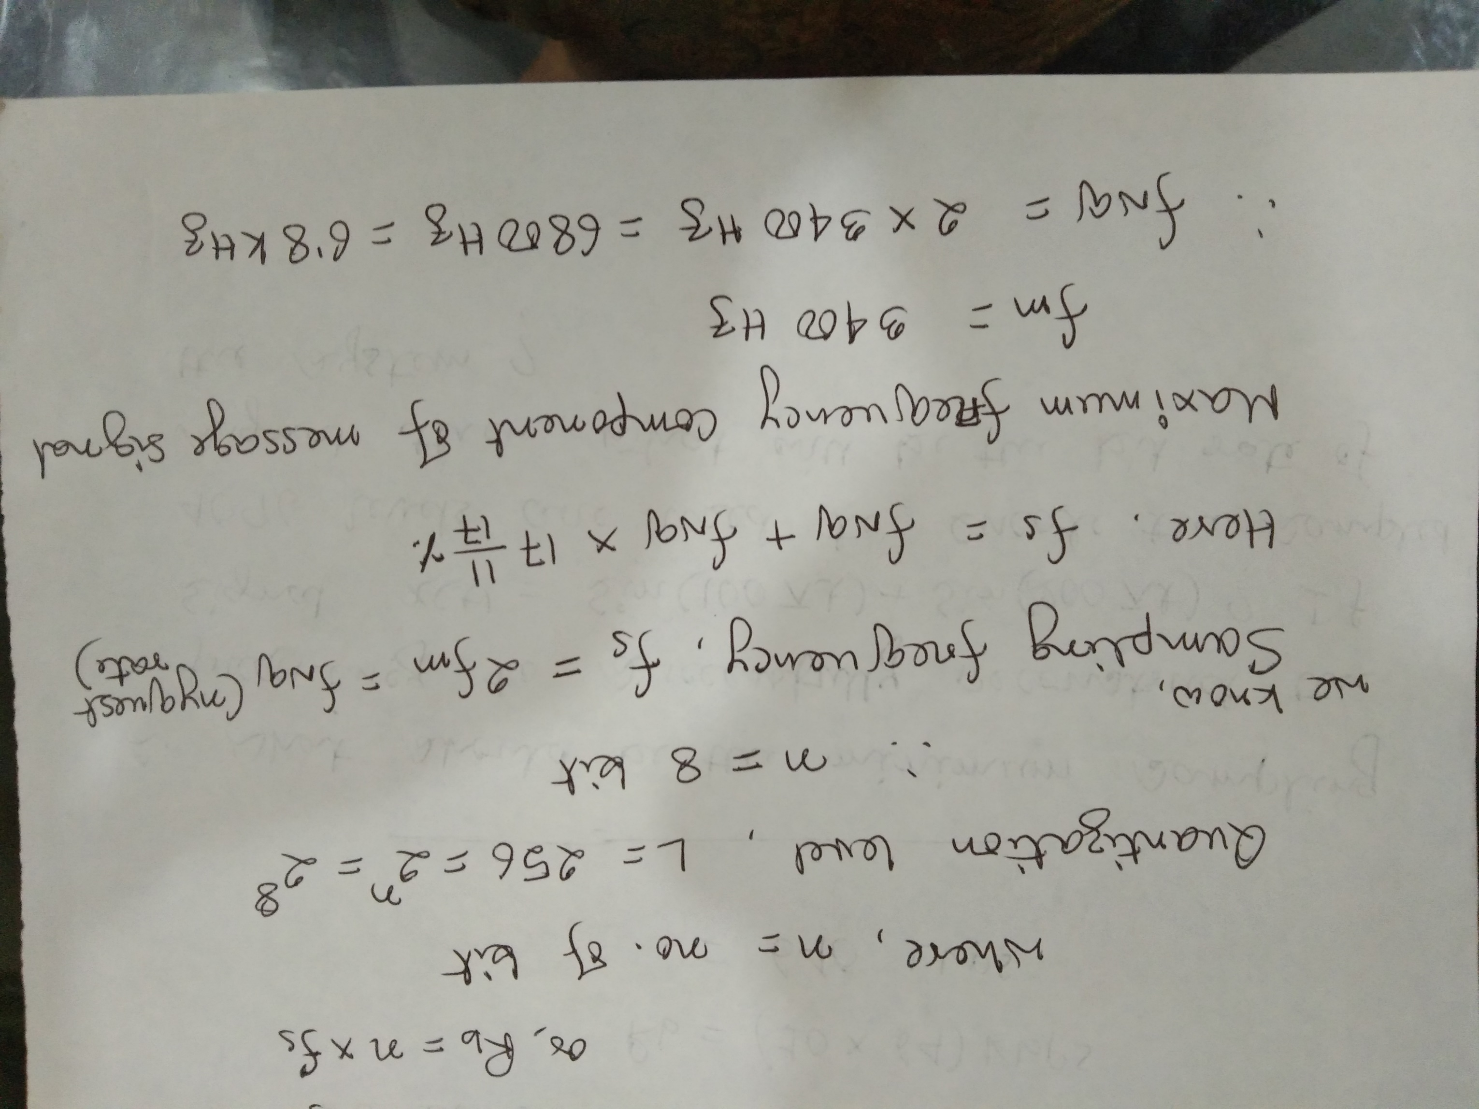

Slide 17
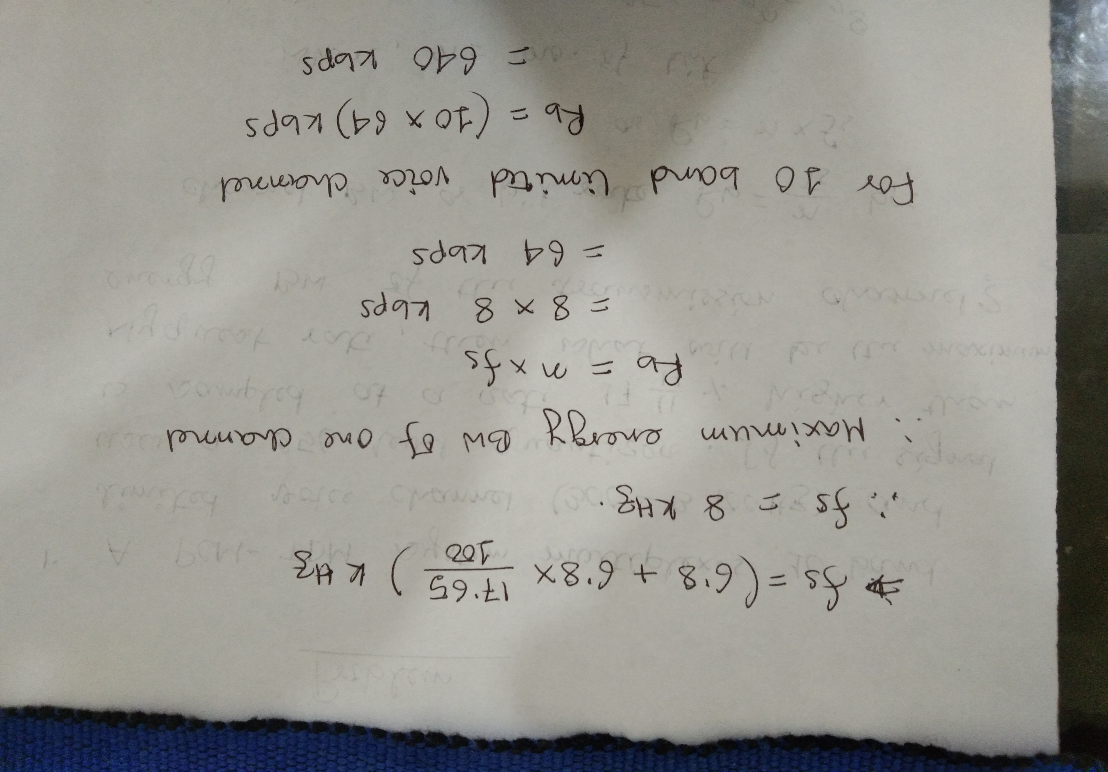

Slide 18
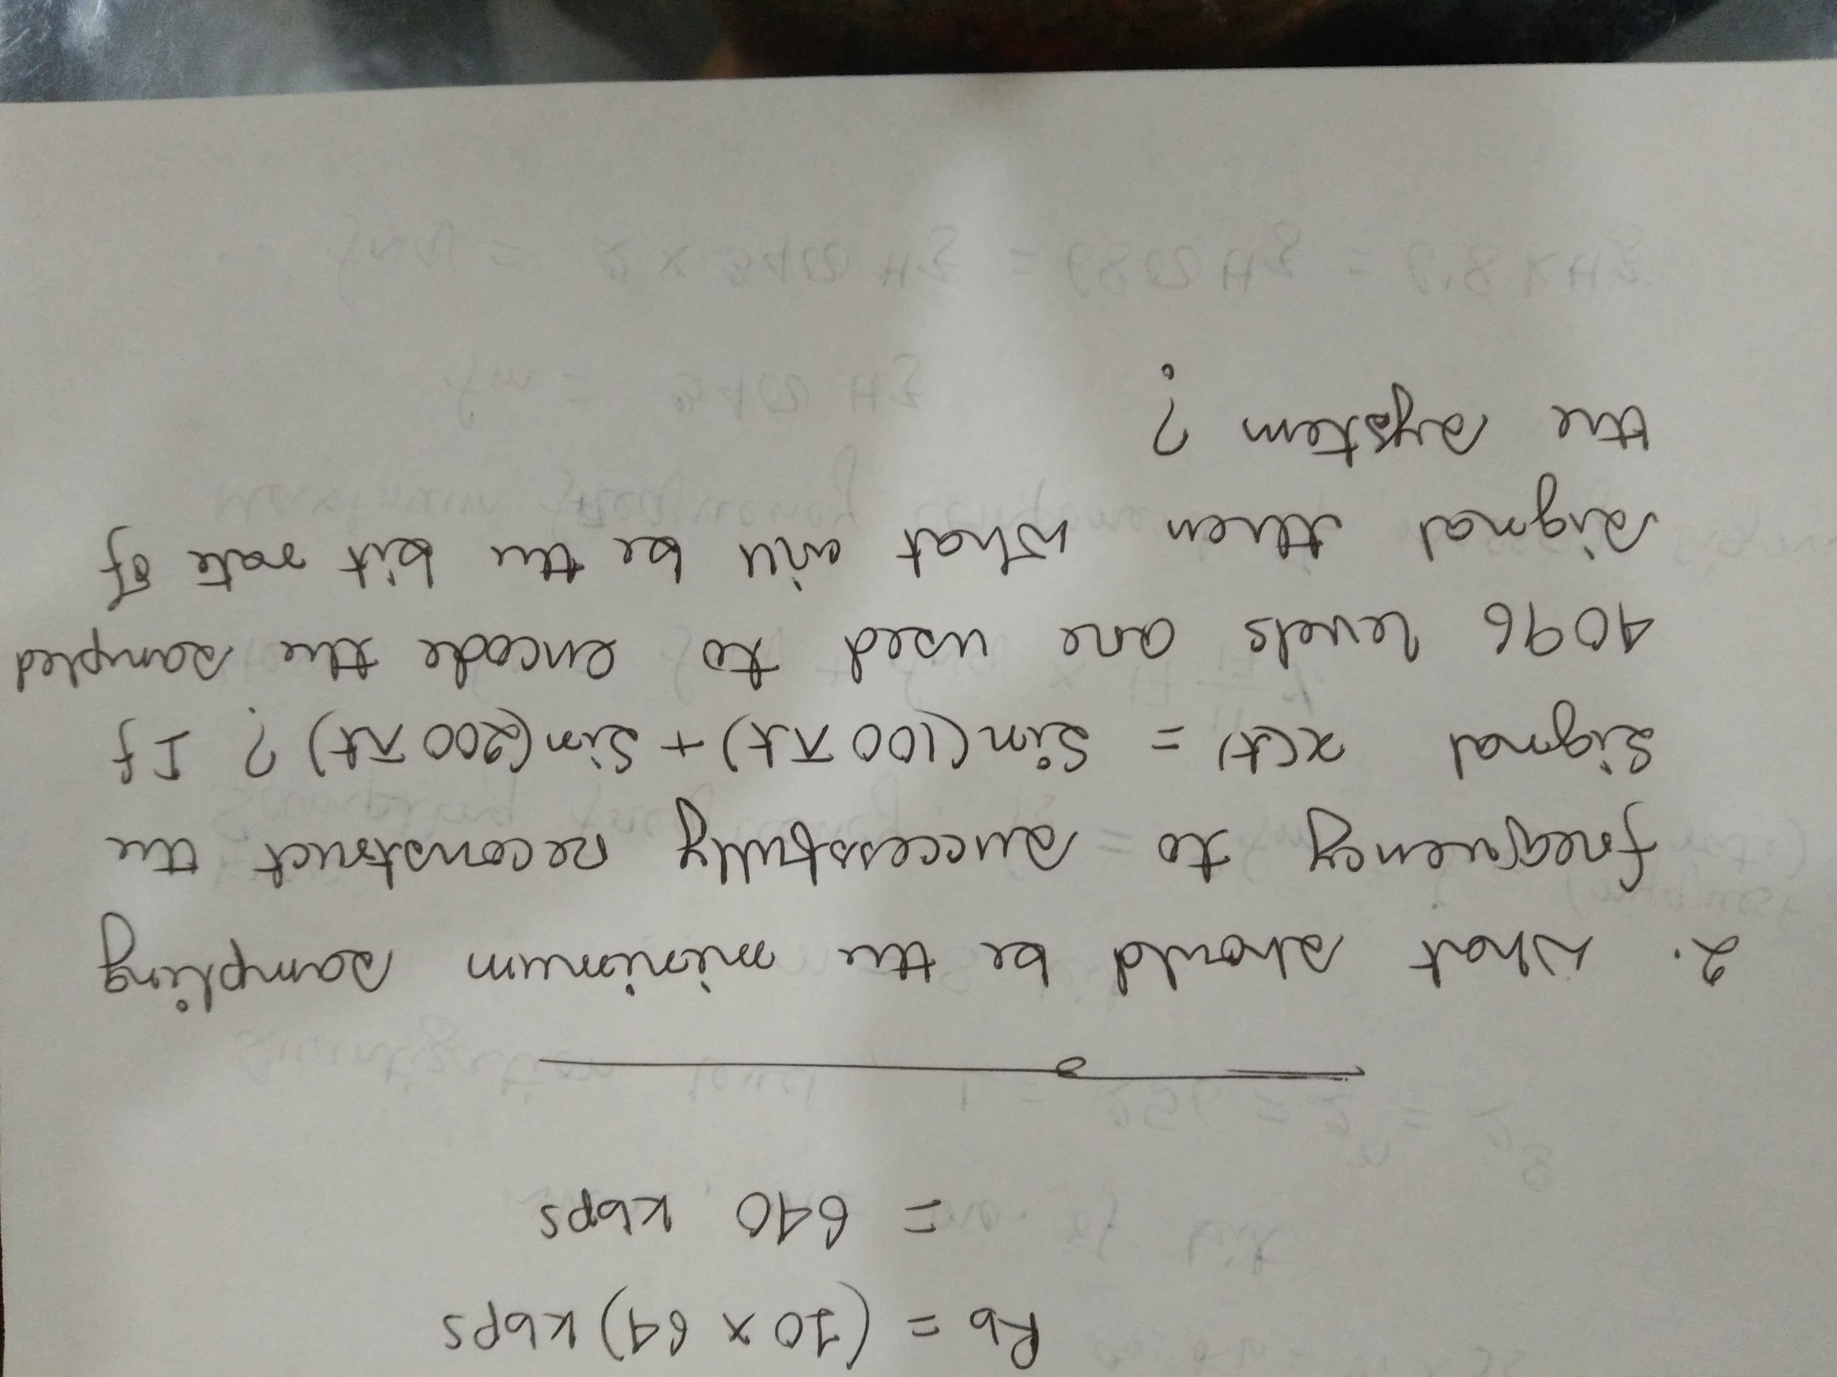

Slide 19
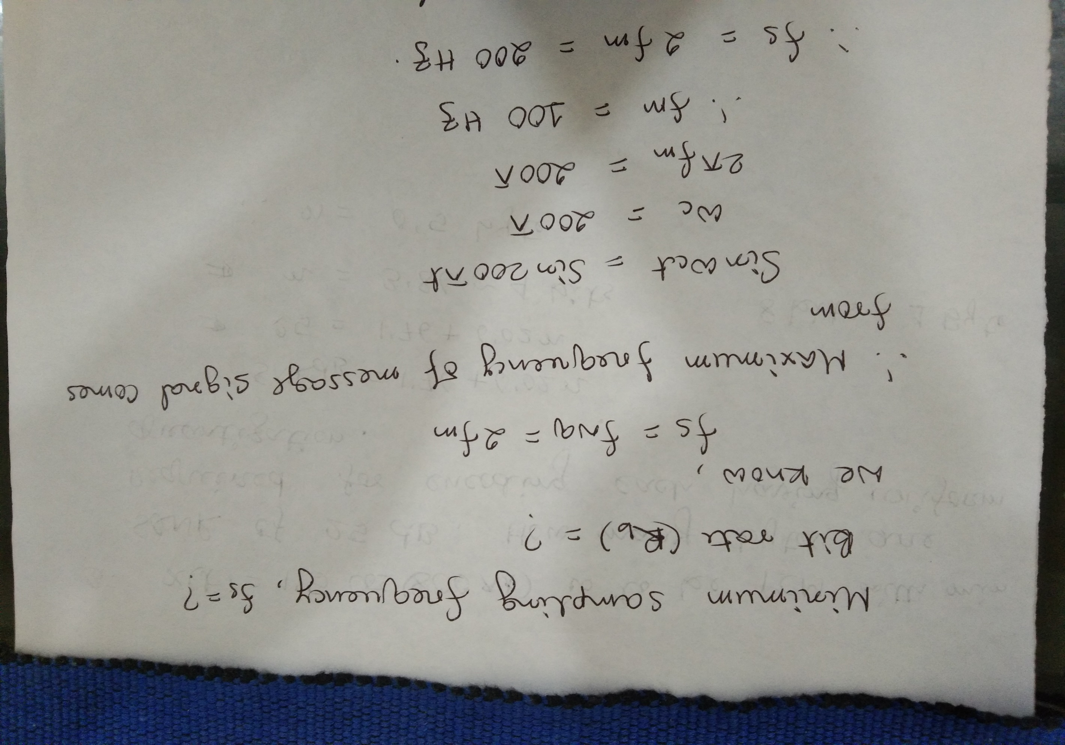

Slide 20
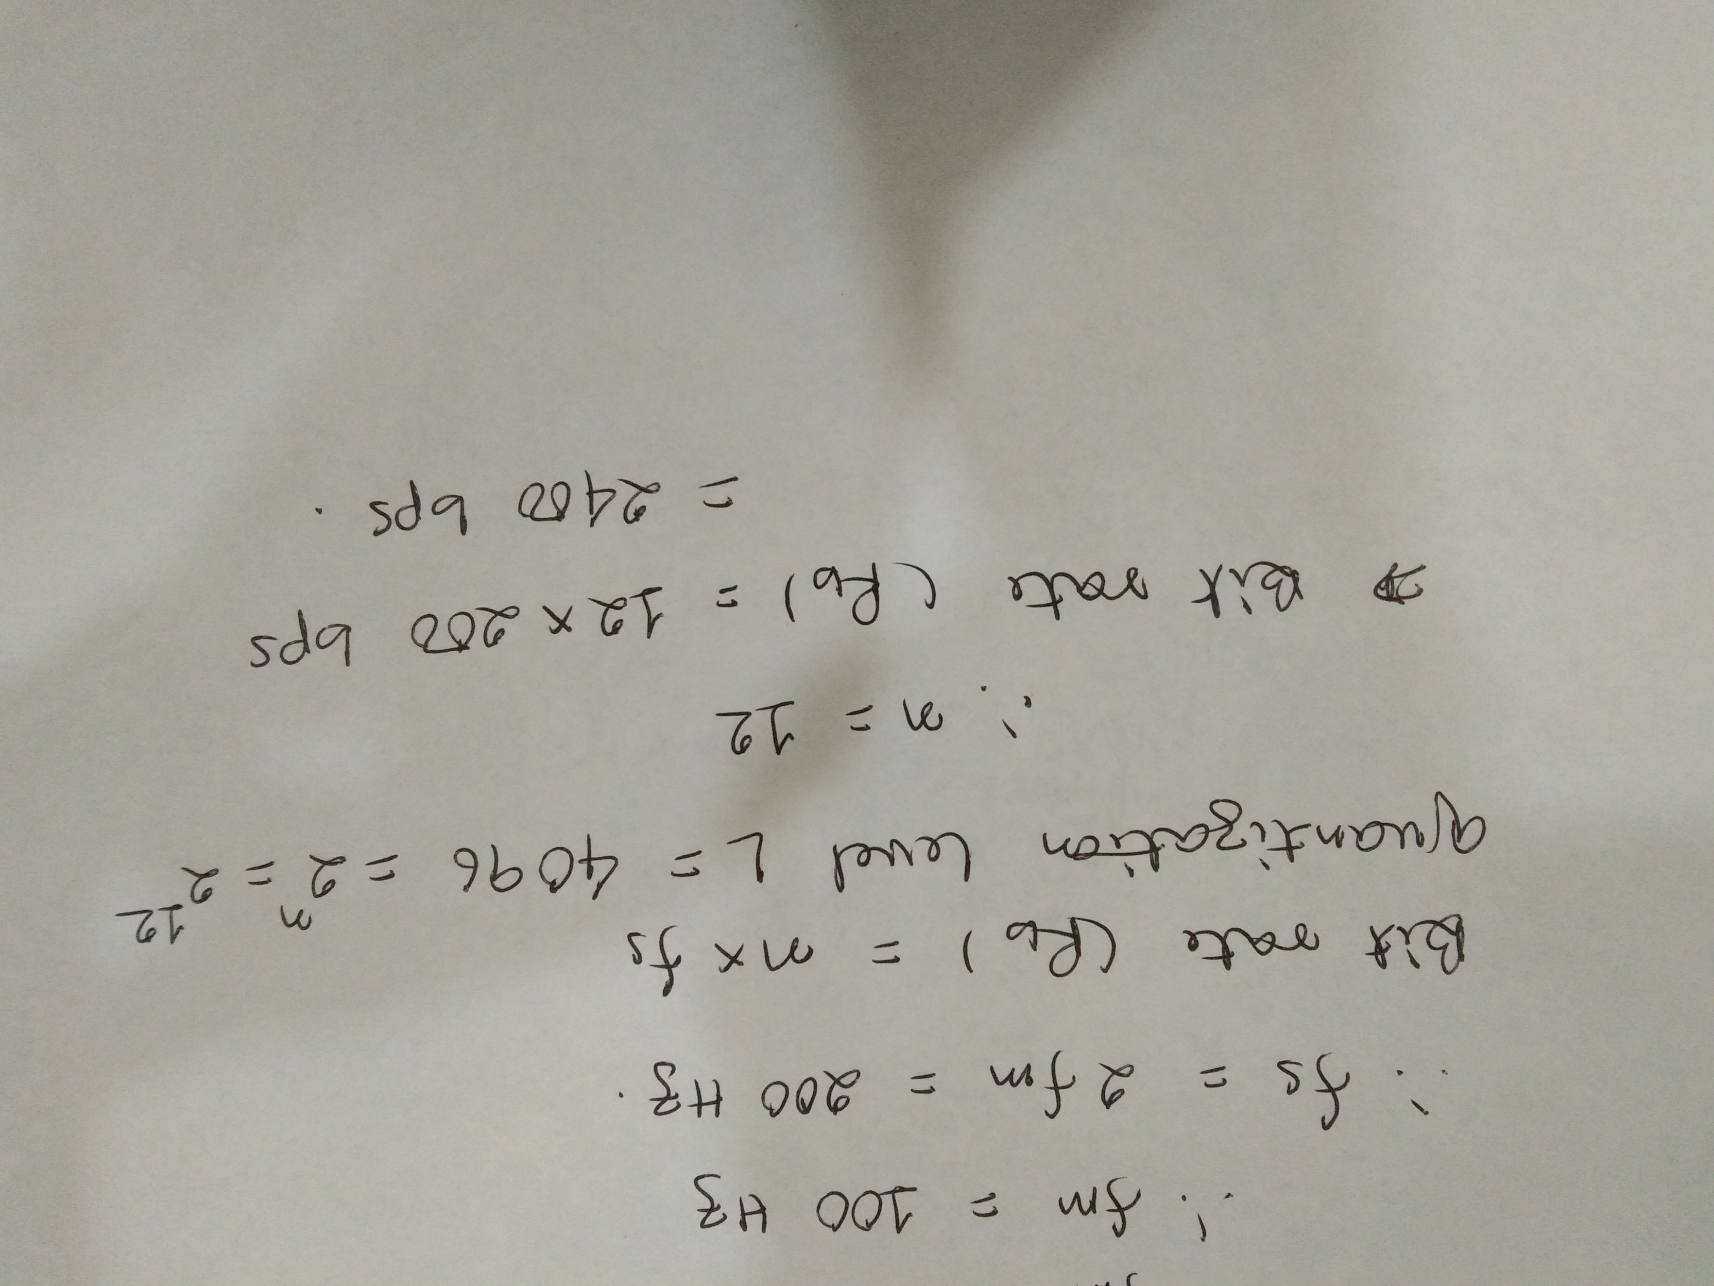

Slide 21
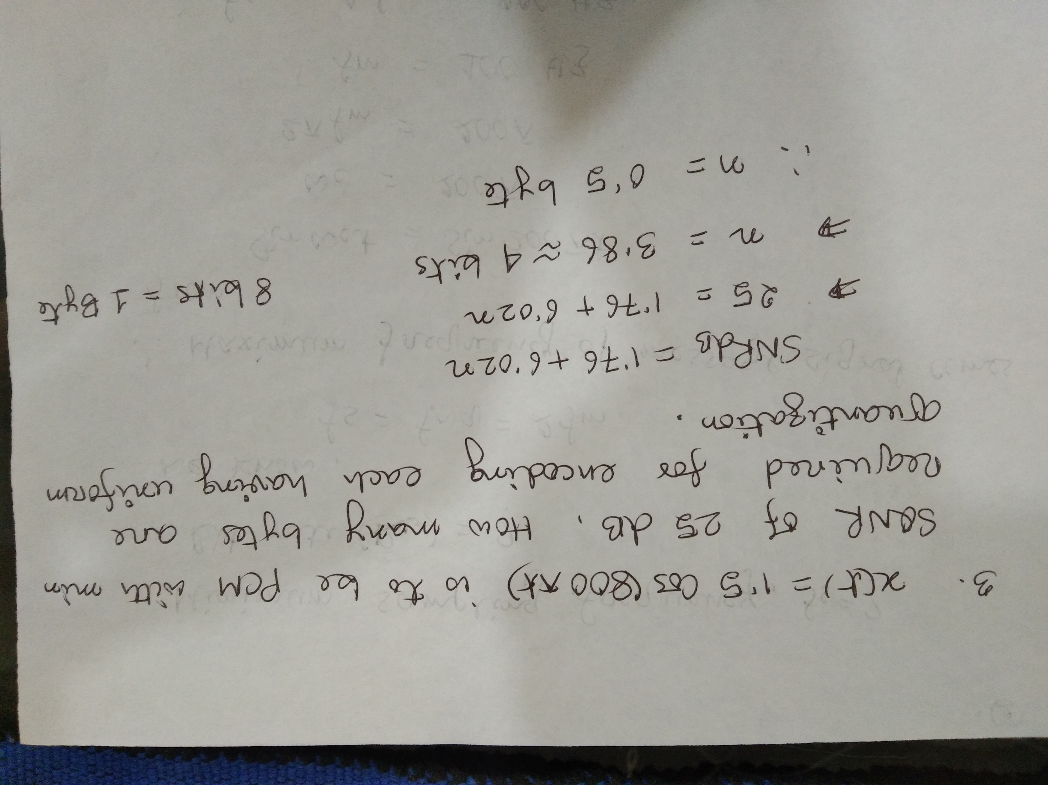

Slide 22
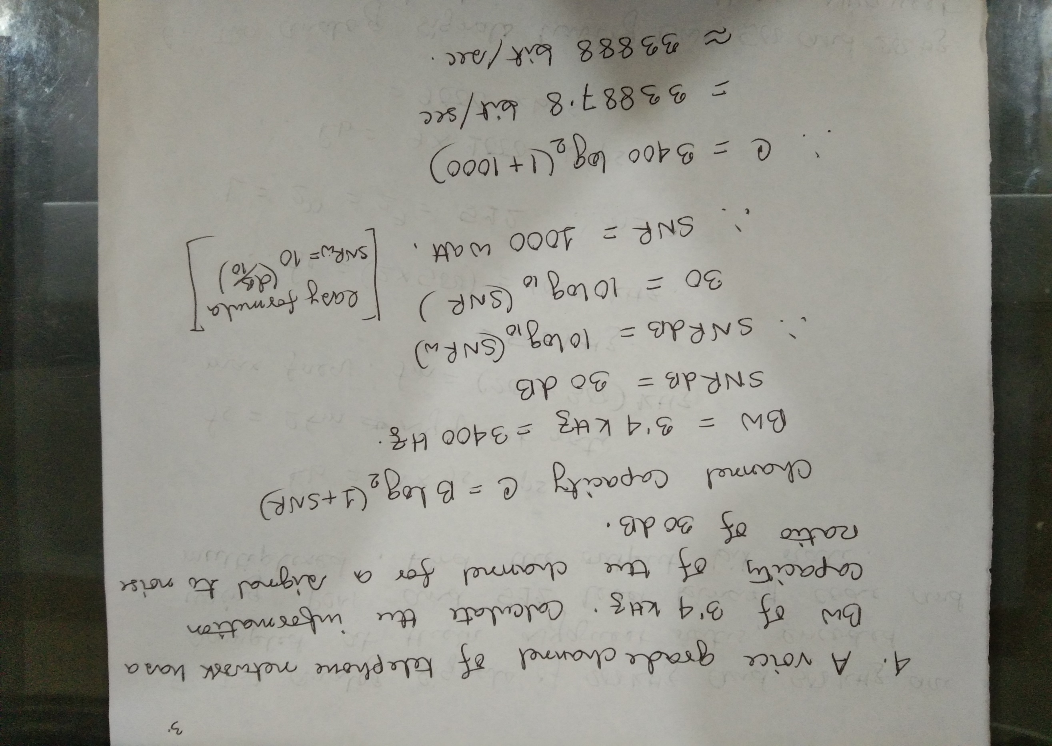

Slide 23
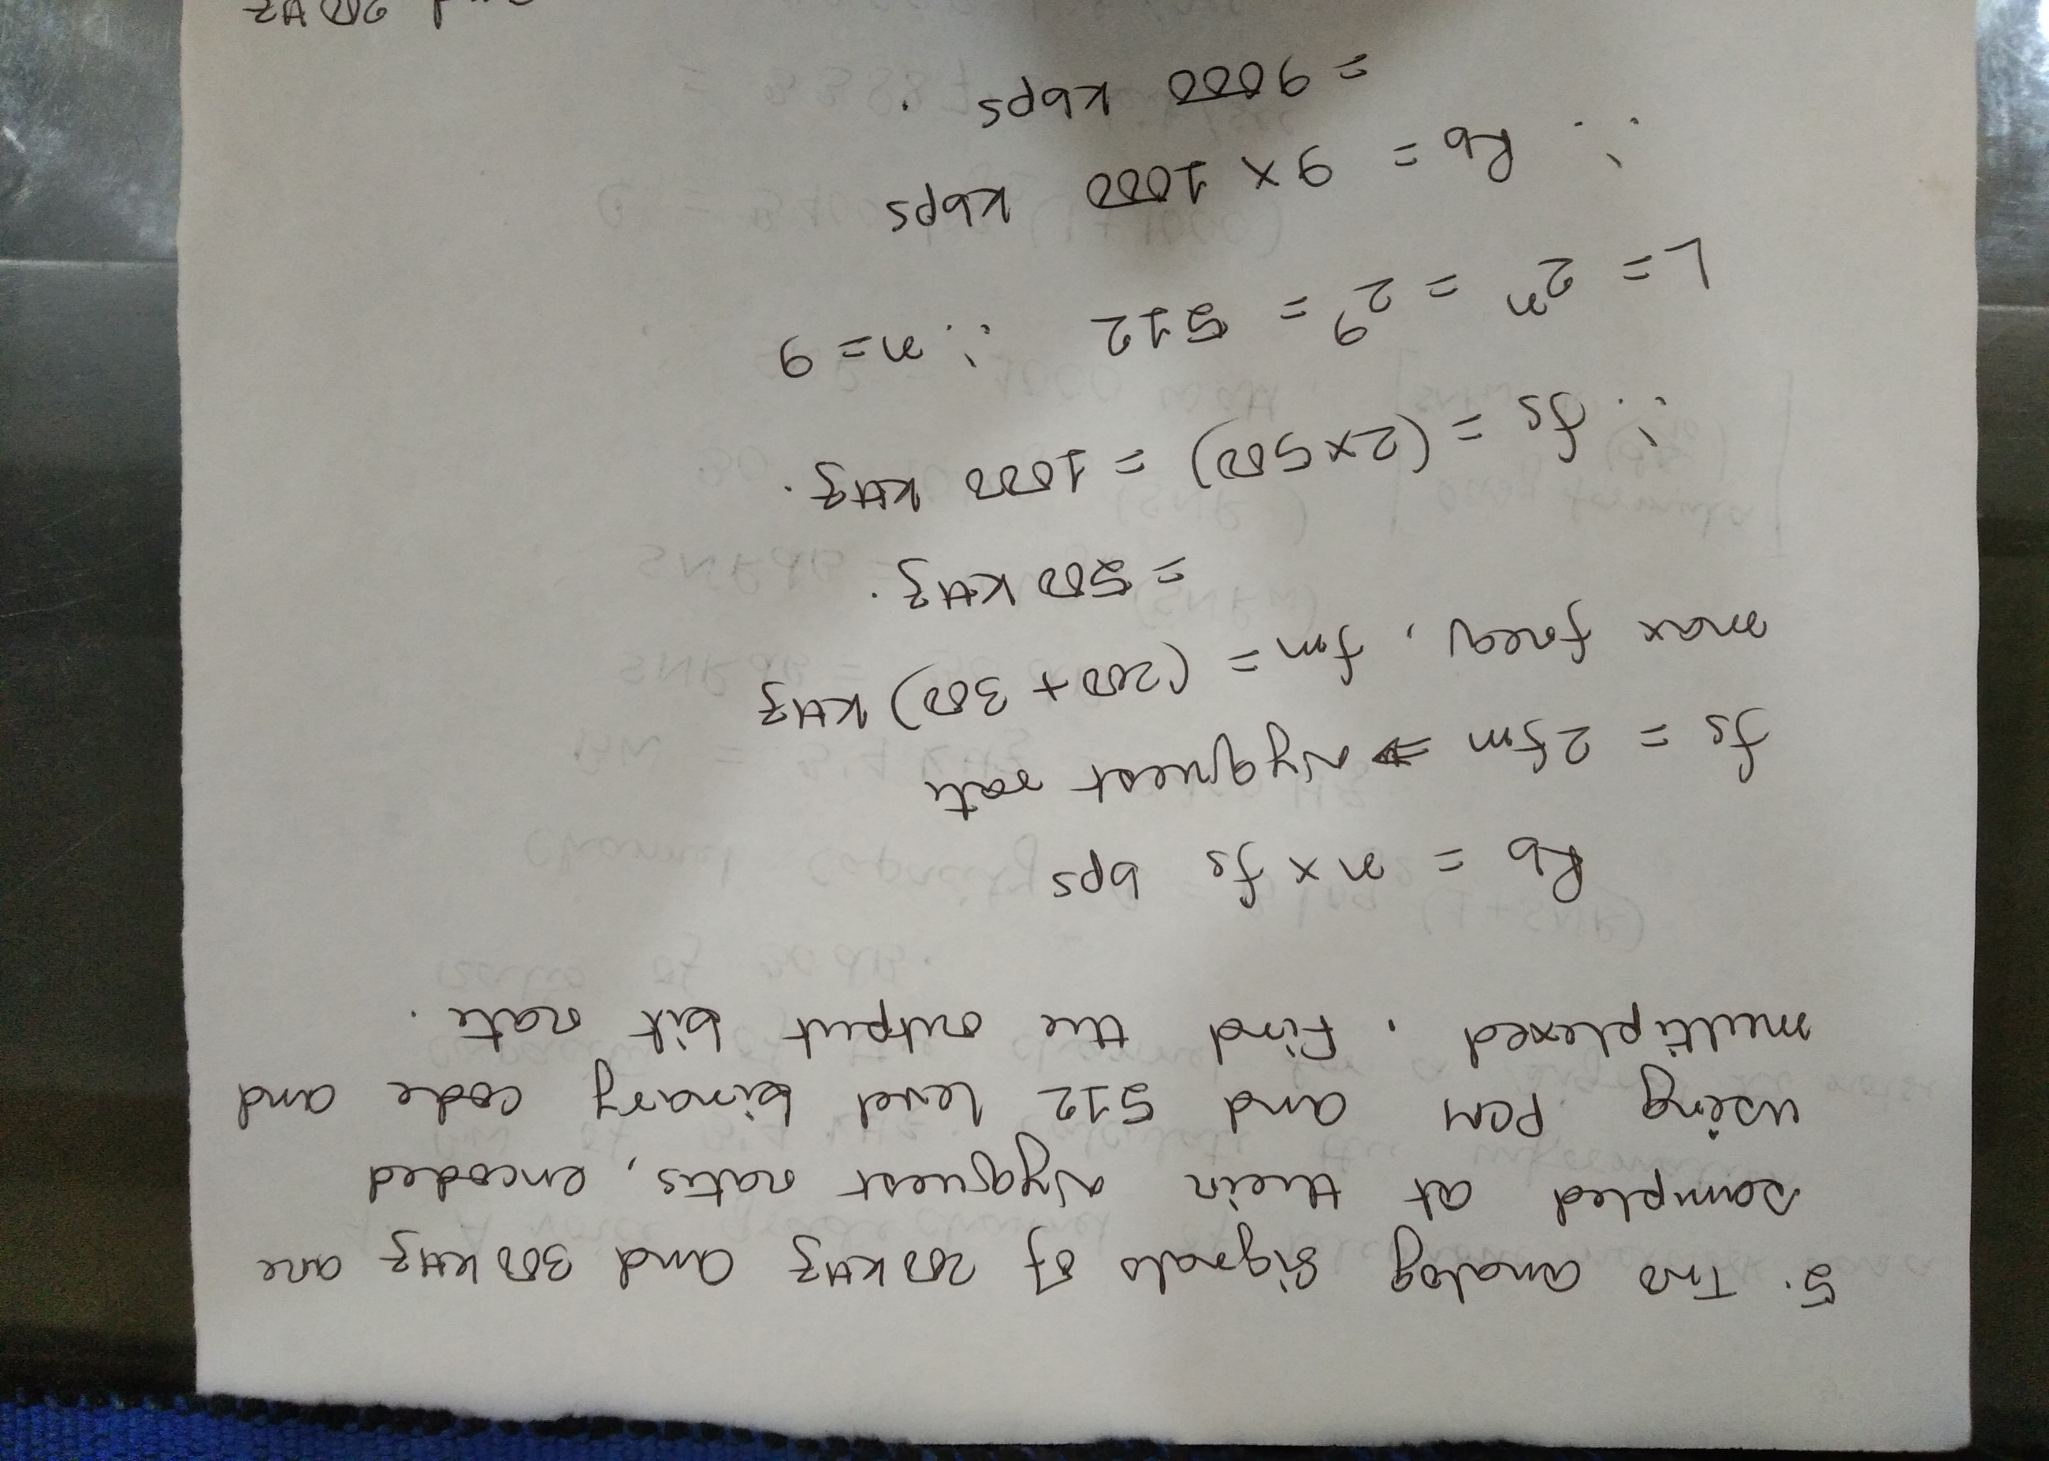

Slide 24
Pulse Modulation

Slide 25
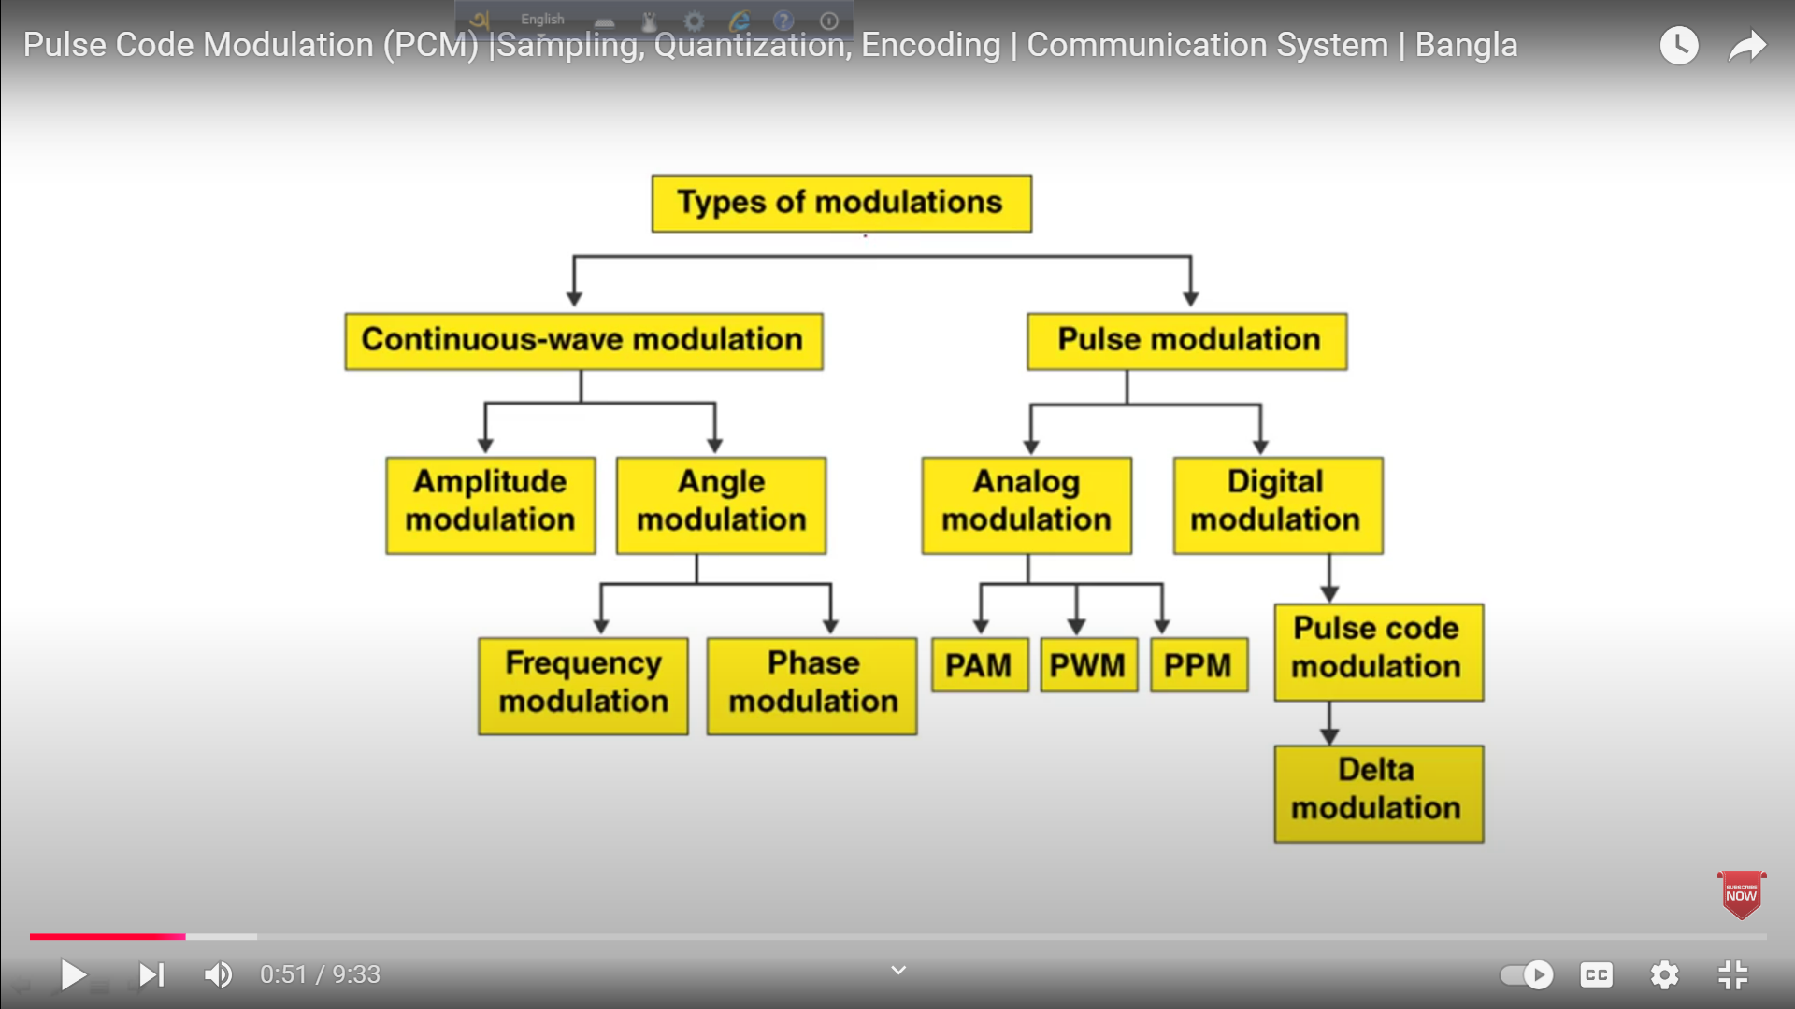

Slide 26
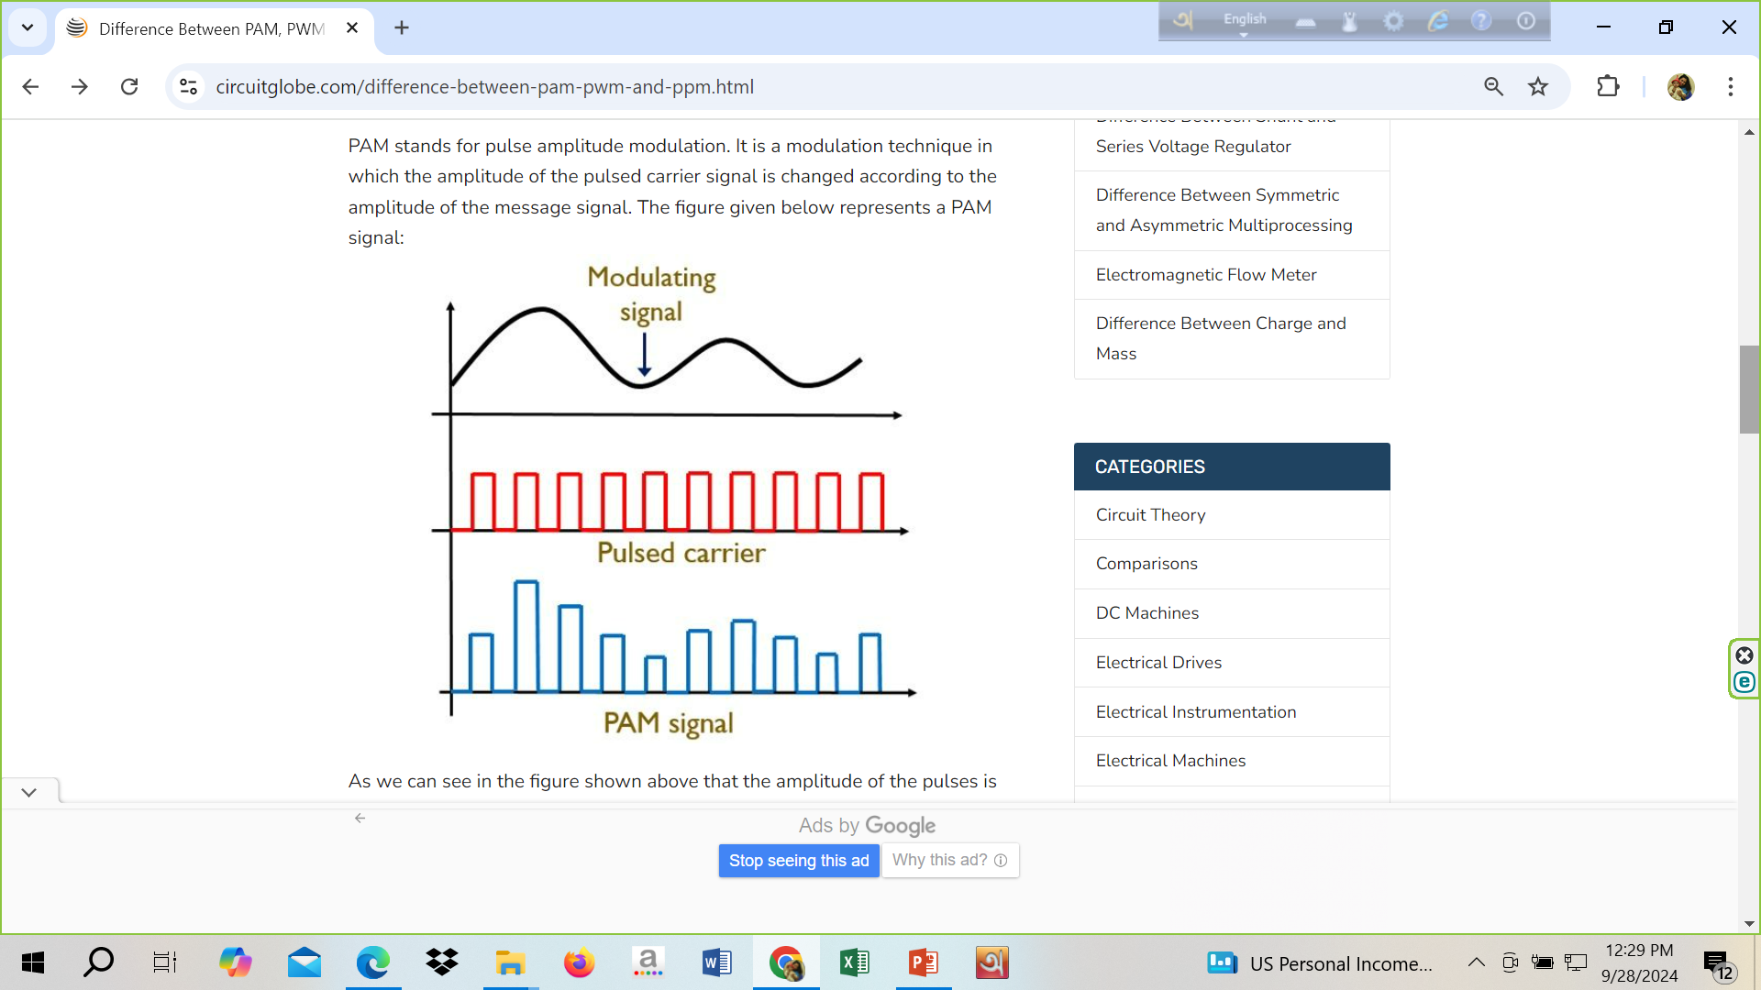
Pulse Amplitude Modulation (PAM)
PAM stands for pulse amplitude modulation. It is a modulation technique in which the amplitude of the pulsed carrier signal is changed according to the amplitude of the message signal.
As we can see in the figure shown above that the amplitude of the pulses is varying with respect to the amplitude of analog modulating signal, like in case of amplitude modulation. But the major difference is that unlike AM, here the carrier wave is a pulse train rather than continuous wave signal.

Slide 27
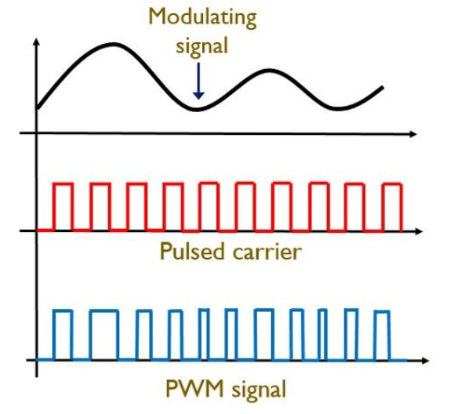
Pulse Width Modulation (PWM)
PWM is an acronym used for pulse width modulation. In PWM the width of the pulses is varied according to the amplitude of the message signal. The figure below shows the pulse width modulated signal:
As we can see that unlike PAM, in this technique the amplitude of the signal is constant and only the width is varying. PWM technique is similar to frequency modulation because, by the variation in the width of the pulses, the frequency of the pulses in the PWM signal shows variation.

Slide 28
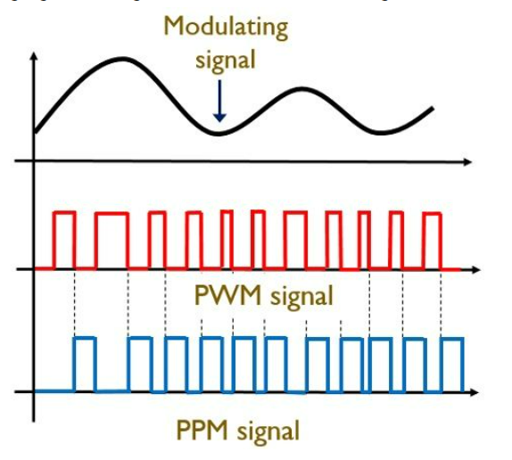
Pulse Position Modulation (PPM)
PPM is used for pulse position modulation. It is a technique in which the position of the pulses is changed in accordance with the amplitude of the modulating signal. The figure below shows the PPM signal:
Here the pulse amplitude and the pulse width are the two constant that does not show variation with the amplitude of the modulating signal but only the position shows variation. It is to be noted here that the position of the pulse changes according to the reference pulses. And these reference pulses are nothing but PWM pulses. Basically, the falling edge of PWM pulses acts as the starting of the PPM pulses.

Slide 29
Key Differences Between PAM, PWM and PPM
A factor that generates a key difference between PAM, PWM and PPM, is that in PAM amplitude of the pulse shows proportionality with the amplitude of modulating signal. In PWM width of the pulses shows proportionality with the amplitude of the message signal. Whereas in PPM the position of the pulses is proportional to the amplitude of analog modulating signal.
PAM technique shows low immunity towards the noise. As against PWM and PPM has low noise interference factor because their noise immunity is high.
In PAM and PWM techniques transmitter and receiver, synchronization is not required. But PPM technique needs synchronization between transmitter and receiver section.

Slide 30
Key Differences Between PAM, PWM and PPM
The SNR is low in case of pulse amplitude modulated signals while it is moderate in case of pulse width modulated signals and highest in case of pulse position modulated signals.
The transmission power in case of PAM and PWM is variable due to variation in amplitude and width respectively. However, it is constant in case of PPM because both amplitude and width are constant in case of PPM.
In PAM, transmission channel bandwidth relies on the pulse width. But in case of PWM and PPM, rise time of the pulse is a factor on which the transmission channel bandwidth depends.
As the position of the pulses is changed in PPM, therefor it requires synchronization pulses. While both PAM and PWM do not require synchronization pulses.
All PAM, PWM and PPM show similarity in implementation with AM, FM and PM respectively.
The bandwidth requirement is low in case of PAM but is comparatively high in case of PWM and PPM.

Slide 31
